Slide 1

Data Analytics - Final Project
Project 2. Guidelines

Slide 2
Final Project - Where should I start?
It is now time to think about and plan your final project! Some key points:
<_Tools_> Jupyter (MUST), Trello, any visualization software (Tableau, Qlik…)
<_Deliverable_> Final Presentation of maximum 10 slides. Be synthetic and go to the bullet and key points of the project
<_Demo Day_> you will present the results in 8m! Meet and convince the audience

Slide 3
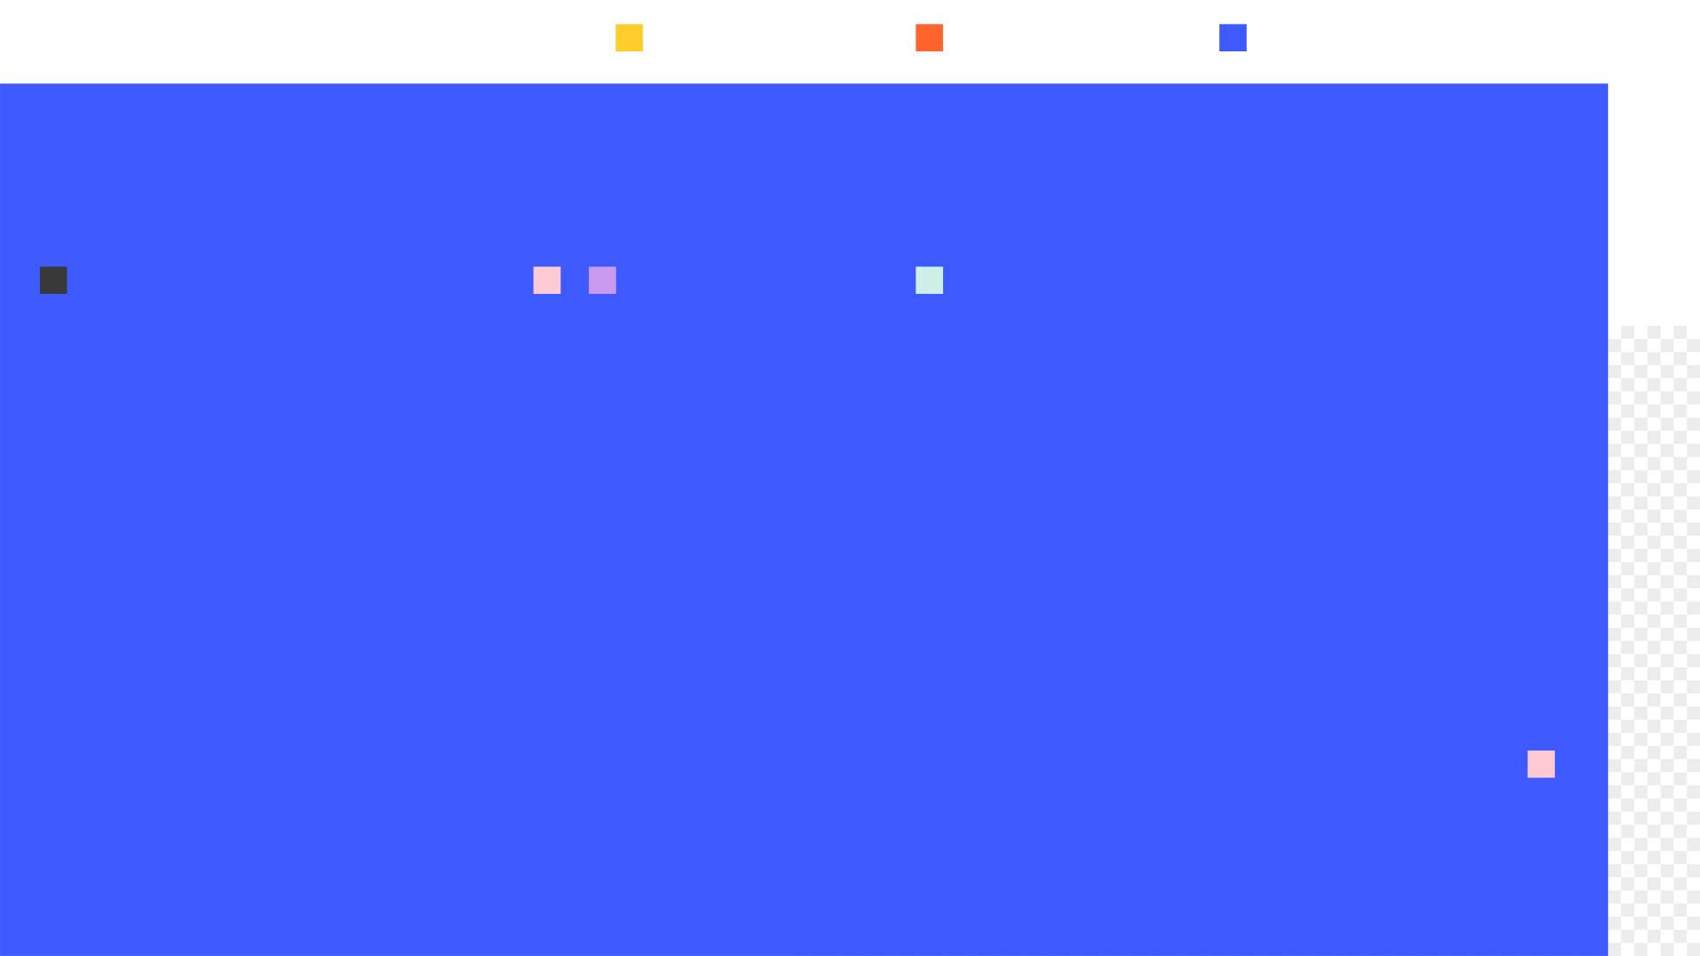
allwomen.tech
<
_ Data Analytics _
100% based on Data Analytics and Visualization
Profile matching: students with high analytical skills that want to develop their career into more Analytics profiles (Business Analytics, Data Analytics…)
>

Slide 4
Data Analytics Project
What is the AIM of the project?: Explore all the capabilities around Data Analytics and create a good exploratory analysis together with powerful conclusions
What is expected from you?: Exploratory Data Analysis (EDA), Data Cleaning, Feature Engineering, combination of more than one dataset (at least three) and powerful plots and visualizations
Time spend on each task: Exploratory Data Analysis (EDA) and data cleaning (60%), Feature Engineering (5%), combination of more than one dataset (5%) and powerful plots and visualizations(30%)
Tools required: Jupyter (including plotting libraries such as Plotly) and any visualization software (Tableau, Qlik …). Please note that most of the visualization softwares have a demo trial for 1 month.

Slide 5
Data Analytics Project - Goals by week
Week 1 (15 hours)
Define the objective of the project
Pre- Exploratory Data Analysis : select the datasets and discard the ones that are not useful.
Define the visualization tool that you are going to use
Exploratory Data Analysis and Cleaning of dataset 1: missing values, descriptive statistics (univariate and bivariate), data cleaning...

Slide 6
Data Analytics Project - Goals by week
Week 2 (25 hours)
Exploratory Data Analysis and Data Cleaning dataset 1: missing values, descriptive statistics (univariate and bivariate), cleaning...
Start with some visualizations in Python (remember to save them!)
Exploratory Data Analysis dataset 2: missing values, descriptive statistics (univariate and bivariate)...
Start with some visualizations in Python (remember to save them!)

Slide 7
Data Analytics Project - Goals by week
Week 3 (15 hours)
Exploratory Data Analysis dataset 2: missing values, descriptive statistics (univariate and bivariate)...
Powerful visualizations with Python (remember to save them!)
Powerful plots with the selected visualization software
Make your final presentation!

Slide 8
allwomen.tech
<
Thank you! Gracias! Merci!
hello@allwomen.tech
allwomen.tech
>

